Slide 1

Analyzing NYC Citi Bike System
Will It Be A Busy Day For Citi Bikes Today ?
Miners “R” Us

Slide 2
AGENDA
The Data
Data Preprocessing
Exploratory Data Analysis
Descriptive Analysis & Summary
Data Visualization
Predictive Analysis
Decision Tree
Logistics Regression Model

Slide 3
INTRODUCTION
Citi Bike is the most widely used bike sharing program in New York City and Jersey City.
Citi Bike was proposed in an effort to
reduce emissions
reduce collisions and road transit congestion
improve public health

Slide 4
Scope
New York City Boroughs
Goal
To predict the usage of Citi Bikes based on demographic variables available in the CitiBike dataset.
Citi Bike Stations and Routes

Slide 5
The Data
2016 Citi Bike Dataset - https://www.citibikenyc.com/system-data
Observation – Sequential order of each trip taken
Variables – Trip Duration, Start Time and Date, Stop Time and Date, Start Station Name, End Station Name, Station ID, Bike ID, User Type, Gender, Year of Birth
2016 Weather Dataset – Kaggle
Observation - Sequential order of weather parameters for each day
Variables – maximum temperature, minimum temperature, average temperature, precipitation, snow fall, snow depth

Slide 6
Data Pre Processing
Replaced Null Values with Mean
Aggregation Function – Gender, User Type, Age
Aggregation of Weather Dataset
Indicators – Weekend & TripsMorethan38K

Slide 7
Aggregated Dataset
Numerical | Categorical
Date | WeekendIndicator
Male | Days
Female | Morethan38K
Subscriber
Customer
Maximum temperature
Minimum temperature
Average temperature
Snow fall
Age Groups
Trips
Miles Travelled

Slide 8
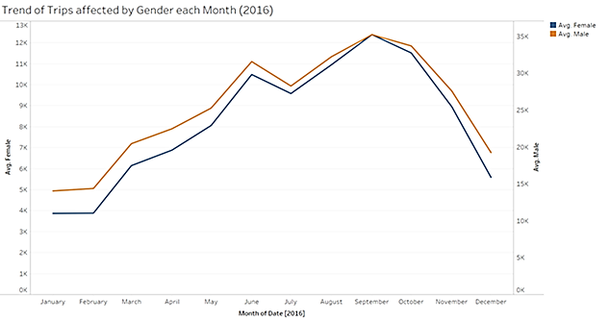
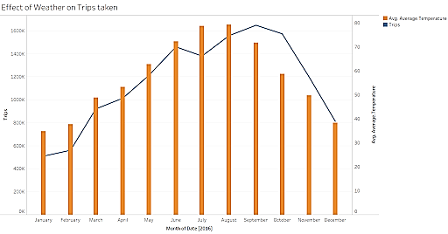
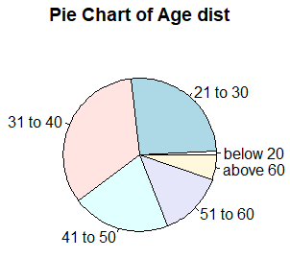
Exploratory Analysis

Slide 9
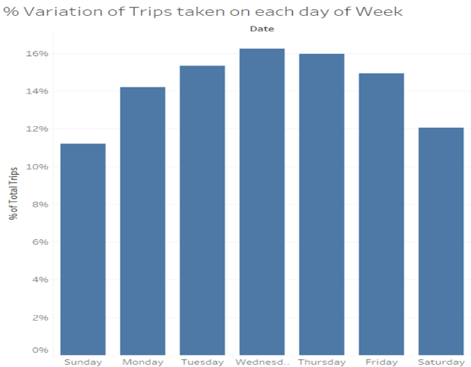
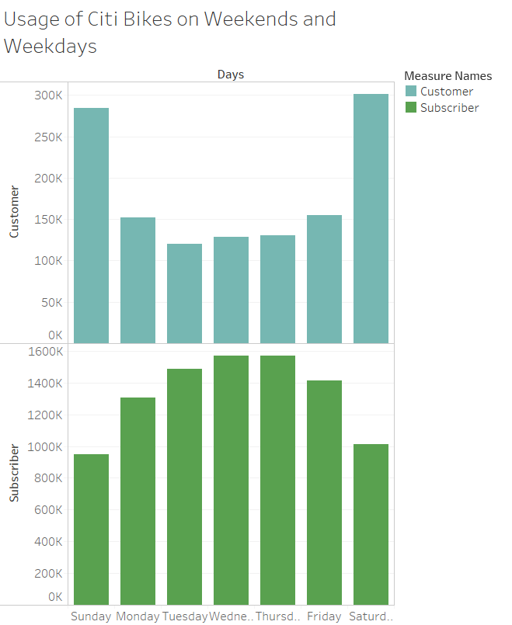
Exploratory Analysis

Slide 10
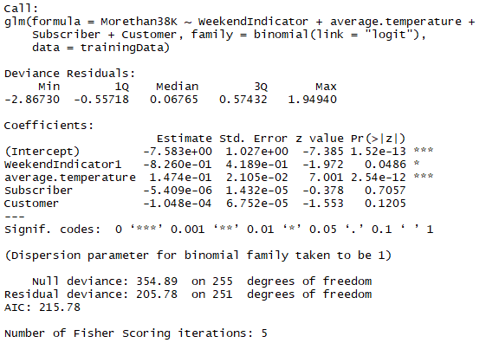
Predictive Analysis – Logistic Regression Model
Predict whether usage of Citi Bikes will me more than 38K

Slide 11
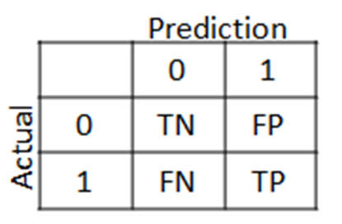

AIC Value (Akaike Information Criteria)
WeekendIndicator and AverageTemperature the AIC value was 220.39
WeekendIndicator, AverageTemperature, Subscriber and Customer the AIC value lowered to 215.78
Residual Deviance Value
WeekendIndicator and AverageTemperature the Residual value was 209.26.
WeekendIndicator, AverageTemperature, Subscriber and Customer the Residual value lowered to 205.78.
Confusion Matrix
Accuracy of Model = (TN + TP) / (TN+TP+FN+FP)
Accuracy = 0.8207547

Slide 12
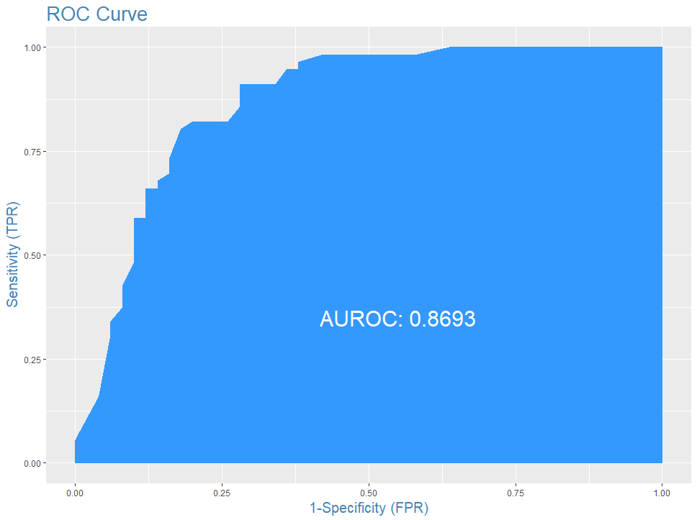
ROC (Receiver Operating Characteristic) Curve
Truth detection rate of 91% on test data is good
Area under ROC curve is 86.93% which is pretty good

Slide 13
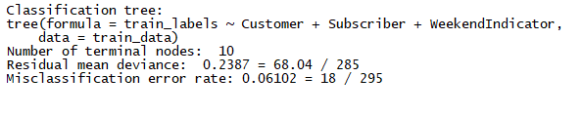
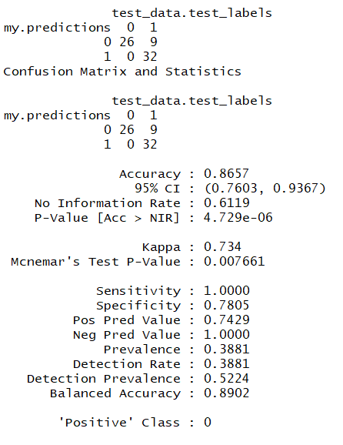
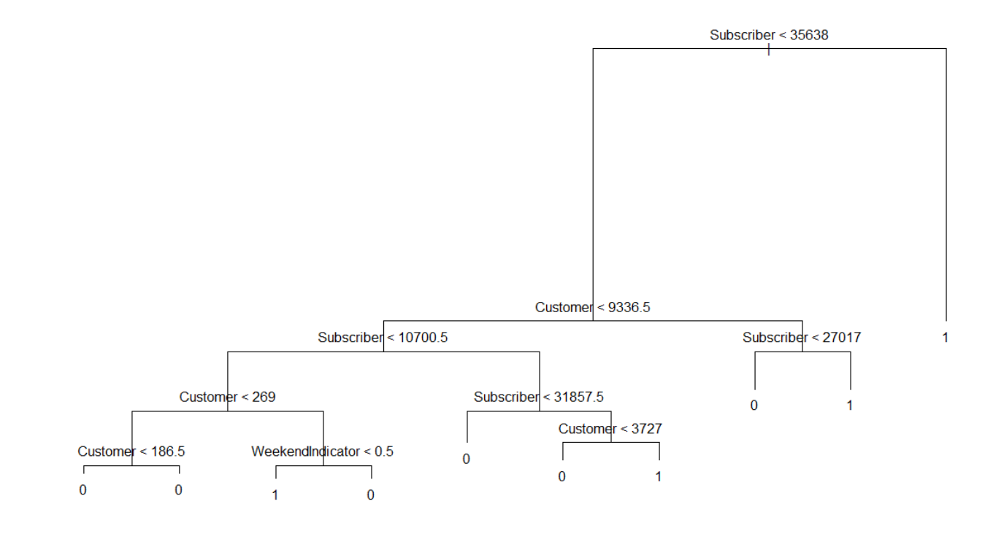
Predictive Analysis – Decision Tree
Using 2 Decision Tree models, we were able to select which variables best predict usage (MoreThan38K).
Model 1:
Input Variables: Customer + Subscriber + WeekendIndicator (no Average Temperature)
Label: MoreThan38K

Slide 14
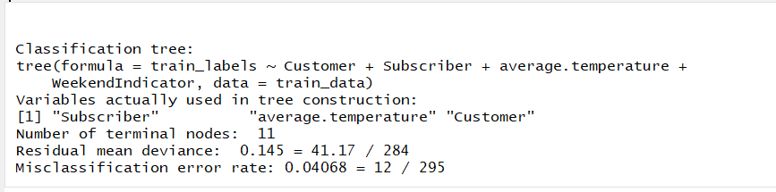
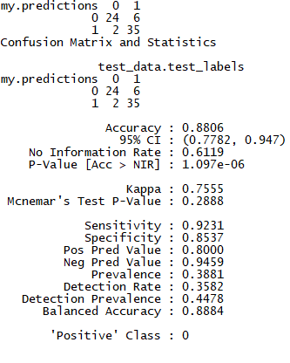
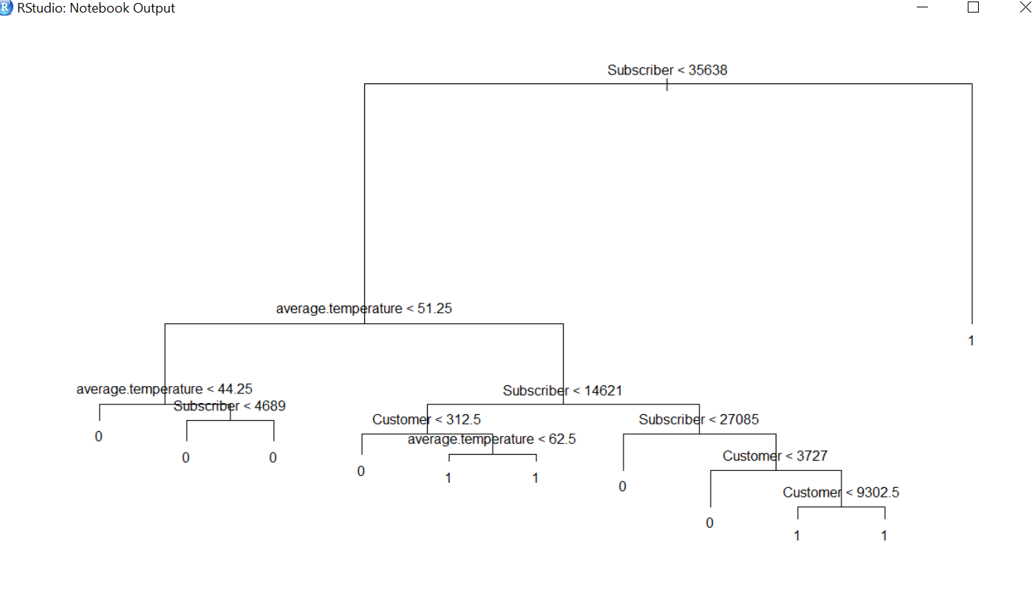
Predictive Analysis – Decision Tree
Model 2: How will accuracy change with the following variables?
Input variables: Customer + Subscriber + Average Temperature + WeekendIndicator
Label: Still MoreThan38K

Slide 15
Conclusion
The prediction of Usage is based on Customer, Subscriber, WeekendIndicator and AverageTempearture.
Using Logistic Regression, the accuracy rate is 82%
Using the decision tree confusion matrix, the accuracy of our model is 88%.
Using EDA and Predictive Models, we find that user type (Subscriber & Customer), Day of Week(Weekend Indicator), are the best indicators of usage for a given day.
Citi Bike can optimize their maintenance resources to improve stations and bikes during anticipated higher-usage days.

Slide 16
Thank You!

